Slide 1
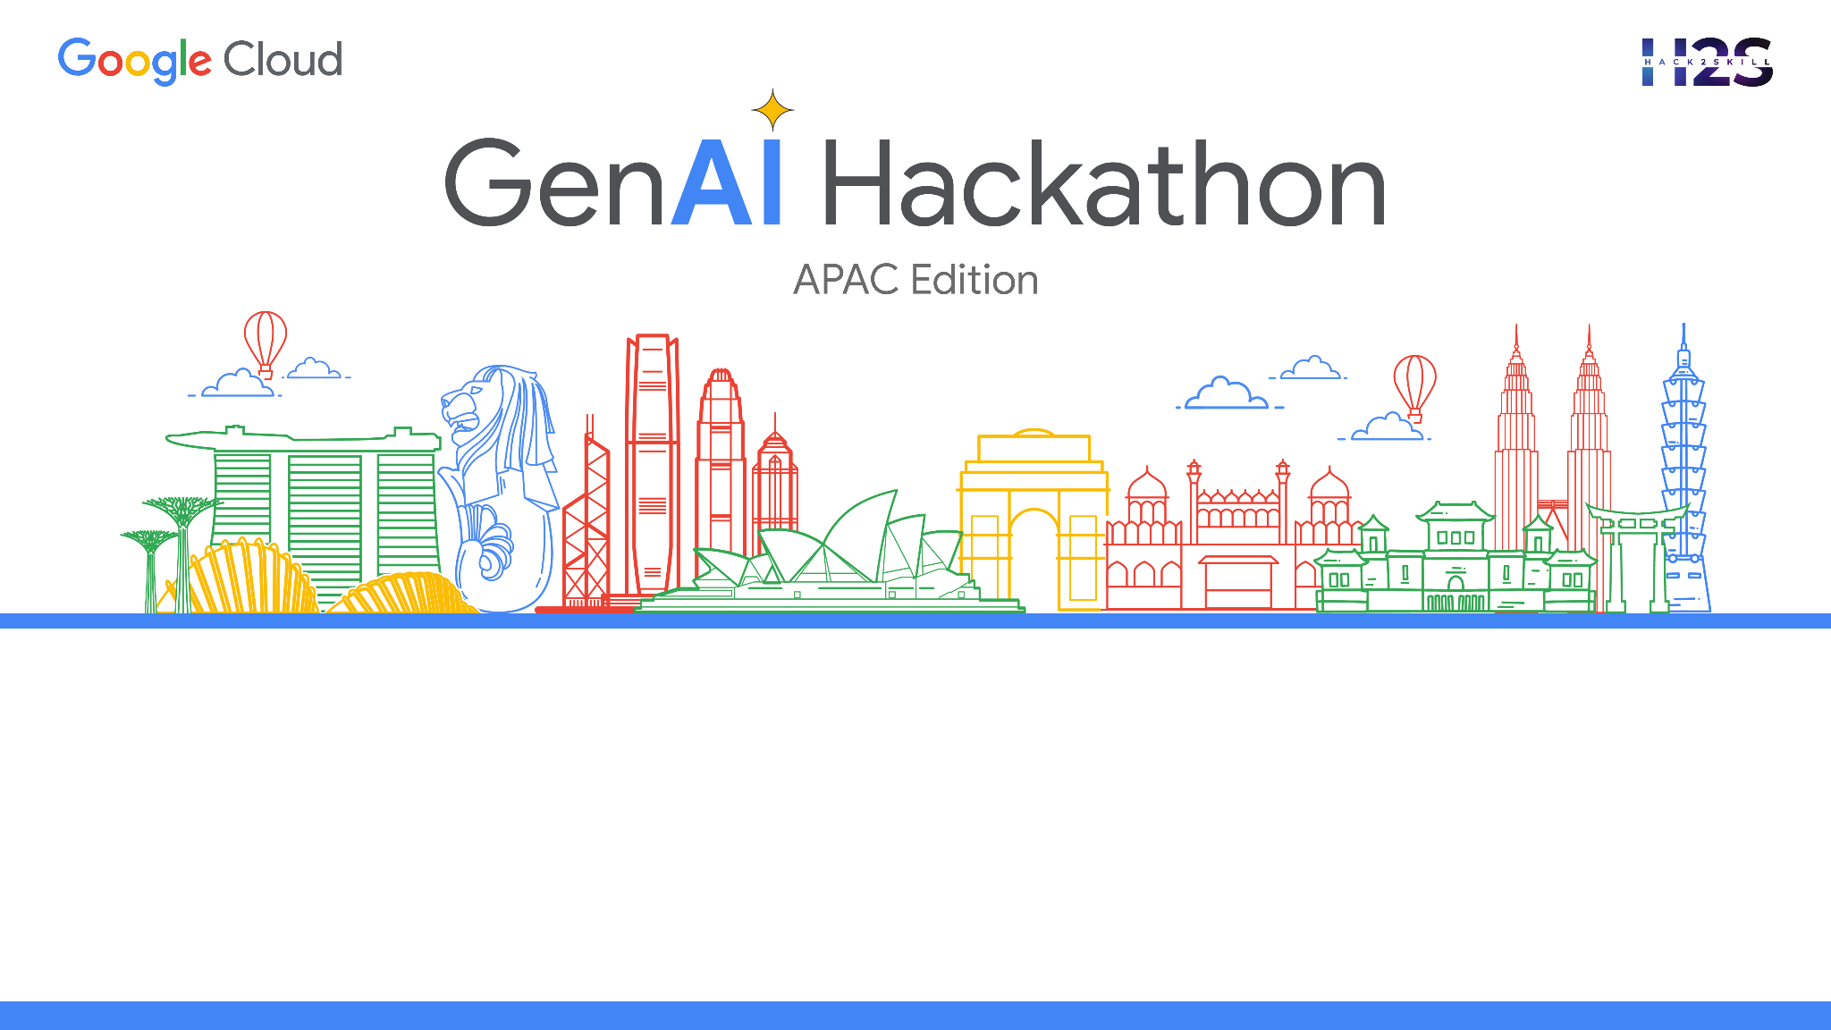
Team Name : Decode
Problem Statement : Interviewmate AI-Powered Interview Practice Platform

Slide 2

Brief about the Idea:
The "AI Interview Assistant" addresses the challenges faced by companies and users in the hiring process. Traditional interview methods often lack efficiency and objectivity, leading to lengthy processes and biased decisions. Candidates struggle to effectively communicate their skills, while recruiters face difficulties in assessing candidates fairly. This application streamlines the interview process by leveraging AI technology. It provides personalized interview questions tailored to each candidate's profile, interactive AI assistance during interviews, and comprehensive evaluations. This ensures a more efficient and fair interview experience for both parties. Candidates gain confidence and refine their skills, while recruiters save time and make better-informed hiring decisions. Overall, the "AI Interview Assistant" simplifies the interview process and improves outcomes for all involved.

Slide 3
Opportunity
The "AI Interview Assistant" presents a unique opportunity to revolutionize the interview process and address key pain points for both companies and candidates. Unlike existing solutions, which may focus solely on one aspect of the interview process, our application offers a comprehensive suite of features designed to cater to the needs of both interviewers and interviewees.
How different is it from any other existing ideas out there?
Existing interview solutions may offer static question banks or basic video recording capabilities, but they often lack the personalization and interactivity provided by the "AI Interview Assistant." Our application stands out by offering dynamically generated interview questions tailored to each user's profile, as well as interactive AI assistance throughout the interview process. This not only ensures a more engaging and relevant interview experience but also provides candidates with valuable feedback and insights to improve their performance.

Slide 4
How will it be able to solve the problem?
The "AI Interview Assistant" revolutionizes the interview experience by automating various aspects of the process. Through personalized interview questions and interactive AI assistance, candidates can better prepare and present themselves. This not only saves time for companies but also ensures fair and objective evaluations. Additionally, the application provides comprehensive feedback, empowering candidates to improve their interview skills over time. By leveraging AI technology, the "AI Interview Assistant" offers a more efficient, fair, and effective solution for both companies and candidates.

Slide 5
List of features offered by the solution :
For Companies: | For Users:
Candidate Management: Employers can efficiently manage candidate profiles within the system, facilitating easy tracking and organization of interviewees. Scheduled Interviews: The platform allows for the scheduling of interviews, ensuring that both parties can allocate time effectively and minimizing scheduling conflicts. Response Dashboard: Upon completion of interviews, candidate responses are promptly delivered to a centralized dashboard for streamlined evaluation and comparison. Evaluation Tools: Robust evaluation tools are provided to assess candidate responses comprehensively. These may include customizable scoring systems and AI-powered analytics to aid in decision-making. | User-Friendly Interface: The application offers an intuitive and user-friendly interface, enabling easy navigation and access to features without technical expertise. Realistic Interview Environment: Users are immersed in a realistic interview setting during recording sessions, enhancing their preparation by simulating real-world scenarios. Result Generation: Post-interview, detailed results are generated, presenting the user's performance metrics in a clear and concise manner for self-assessment. Feedback and Suggestions: Personalized feedback and suggestions are offered to users, highlighting areas of strength and areas for improvement to enhance their interview skills effectively.

Slide 6
Additional Points:
Secure Data Handling: The application ensures the confidentiality and security of user data throughout the interview process, adhering to stringent privacy standards.
Scalability: The solution is scalable to accommodate varying numbers of users and interviews, making it suitable for businesses of all sizes.
Customization: Users have the flexibility to customize interview parameters such as job role, interview type, and experience level to tailor the experience to their specific needs.
Continuous Improvement: The platform undergoes continuous updates and improvements based on user feedback and technological advancements to ensure optimal performance and user satisfaction.
Affordability: The solution offers cost-effective pricing models, making it accessible to both large corporations and small businesses, as well as individual users seeking interview practice opportunities.

Slide 7
Usecase Diagram:
AI Interview Assistants
Company Side
Company Side
Sign Up
Log in
Log in
Create Profile
Interview Execution
Evaluation and Result Generation

Slide 8
Technology used :
Artificial Intelligence (AI): Google Generative AI Model 'gemini-pro'
Web Development Technologies: HTML, CSS, JavaScript.
Backend development: Python, Django.
Frontend development: React, Bootstrap
Database management system: PostgreSQL
Libraries: Voice to Text Converter, Video and Audio Recording.

Slide 9
Estimated cost of/after implementing the solution :
The estimated cost of implementing the "AI Interview Assistant" will depend on various factors such as development time, infrastructure requirements, and ongoing maintenance. However, the potential benefits of improved hiring outcomes and efficiency gains can outweigh the initial investment, making it a cost-effective solution for organizations of all sizes. Additionally, for candidates, the application offers a valuable platform for practicing interview skills at no cost, providing them with a competitive edge in the job market. Overall, the "AI Interview Assistant" offers a high return on investment for both companies and candidates alike.

Slide 10
